Slide 1
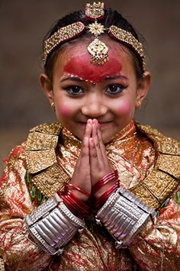
gd:sf/
WEL COME

Slide 2
k|efjsf/L pb\3f]if0f snf tflnd Master of Ceremony

Slide 3
pb\wf]ifs Master Of Ceremony
ljljw kIf jf ljifodf hg ;d'bfonfO{ ljljw s'/f hfgsf/L u/fpg] p2]Zo jf nIon] ;~rfng x'g] sfo{qmddf klxnf] JolQm jf k|ydtM af]Ng] JolQmnfO{ pb\3f]ifs elgG5 .

Slide 4
pb\3f]if0f Annoucement
bz{s jf >f]tf / sfo{qmdsf] lar ;Gt'ng sfod /fVg jf ;+rf/sf] sdL (Communication Gap) x'g glbg pb\3f]ifsn] af]lng] k|lqmofnfO{ pb\3f]if0f elgG5 . ;dli6ut ?kdf eg] sfo{qmd cjlwe/sf] pb\3f]ifssf] cfjfh g} pb\3f]if0f xf] .

Slide 5
pb\3f]if0fsf] lsl;d ?

Slide 6
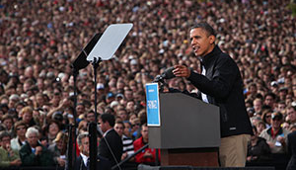
!= k|ToIf pb\3f]if0f
(Direct Annoucement)

Slide 7

@= ck|ToIf pb\3f]if0f
(Indirect Annoucement)

Slide 8
k|ToIf pb\3f]if0f Direct Annoucement
aGb jf v'nf d~rdf bz{sx?;+u k|ToIf ;DaGw /lx ;~rfng x'g] k|lqmofnfO{ k|ToIf pb\3f]if0f elgG5 . o;df ljz]if u/L ;~rfng jf pb\3f]ifs / bz{sx?sf] lar k|ToIf ;Dks{ ug{ ;lsg] cj:yf /xG5 . ;fy} o;df /fd|f] jf g/fd|f] h'g;'s} ePtf klg o;sf] k|ltlqmof tTsfn} k|fKt x'g] cj:yf /xG5 .

Slide 9

ck|ToIf pb\3f]if0f Indirect Annoucement
/]l8of], l6=eL=, l;g]df cflbdf bz{s jf >f]tfx?;+u k|ToIf l;wf ;Dk{s g/xL sfo{qmd ;~rfng ug]{ k|lqmofnfO{ ck|ToIf pb\3f]if0f elgG5 . o;df /fd|f] jf g/fd|f] h'g;'s} ePklg o;sf] k|ltlqmof k|fKt x'g s]xL ;do -306f, lbg jf dlxgf _ nfUb5 .

Slide 10

pb\3f]ifsf] bfloTj
!= lbPsf] sfo{ljj/0f qmdj4 ?kdf k|:t't ug'{ .
@= hg;d'bfo, bz{snfO{ sfo{qmdk|lt cfslif{t u/fO{ /fVg' .
#= bz{s / sfo{qmdsf] aLr ;~rf/sf] vfdL (Communication Gap) x'g glbg' .
$= e"ldsf lgjf{x ug]{nfO{ ;xof]u ug'{ / s[t1tf 1fkg ug'{ .
%= jQmfnfO{ ;dosf] k"0f{ Vofn u/fpg

Slide 11
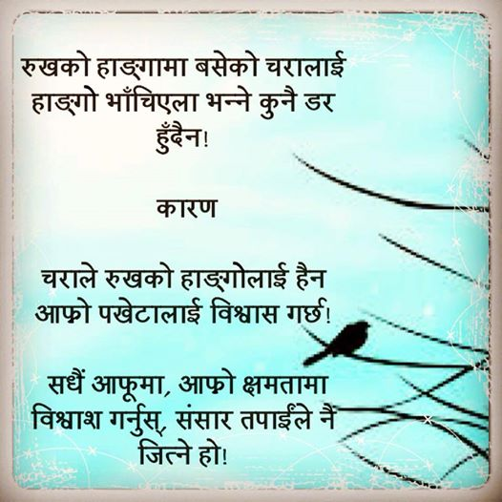
pb\3f]ifssf u'0fx?
!= cfTdljZjf; Pj+ plrt JolQmTj .
@= eflifs z'4tf .
#= bl/of], km'lt{nf] / ;'dw'/ cfjfh .
$=;xL / l56f] lg0f{o lng ;Sg] Ifdtf .
%= cfjZostf cg';f/ k|efjsf/L k|:t'lts/0f ug{;Sg] Ifdtf .
^= ;+If]kLs/f0fsf] v'aL .
&= :j/df ljljwtf .
*=oflGqs j:t'jf/] ;fdfGo 1fg .
(= clegofTds u'0f -dgf]/~hgfTds sfo{qmdsf] nflu _ .

Slide 12
pb\3f]ifsn] ug'{kg]{ k"j{ tof/L
!= sfo{qmd ;~rfng x'g] :yfg / ;dosf] hfgsf/L .
@= bz{s ;+Vof / ;d"xsf] 1fg .
#= cfof]hs ;+:yfsf] ;+lIfKt hfgsf/L .
$= ljz]if JolQmsf] JolQmTjsf] hfgsf/L .
%= sfo{qmd tflnsf / ;DalGwt ljj/0f k|flKt .
^= oflGqs j:t'sf] k"j{ lgl/If0f .
&= k|:t'lts/0fsf] nflu 5gf}6 .
*= sfo{ ljj/0fsf] k"j{ cEof; .

Slide 13
pb\3f]ifsn] ug{ gx'g] s'/fx?
!= gfs, sfg, 6fpsf] sGofpg' .
@= vNtLdf xft /fVg' .
#= z/L/ / v'§f xNnfpg' .
$= ;fFrf] k};f jf cGo j:t' v]nfpg' .
%= pR>[v+n , 7f8f] -ss{z_, zAb jf jfSosf] k|of]u .
^= c:ki6 / pQ]hgfTds x'g' .
&= bz{s / bz{ssf] rfxgf Pj+ jQmfk|lt cgfb/ .
*= lgwf{l/t ;do eGbf al9 ;do lng' .
(= Ifdf ofrgfaf6 pb\3f]if0f k|f/De ug'{ .
!)=nfdf] e"ldsf jf w]/} af]Ng' .
!!= jQmfdfly x:tIf]k .
!@= ;s];Dd ld;fj6 efiff k|of]u gug'{ .

Slide 14

sfo{qmdsf k|sf/x?
!=;df/f]x M pb\3f6g, ;dfkg, x:tfGt/0f, ljdf]rg, clegGbg / jflif{s pT;j .
@= uf]i7L M sfo{zfnf, ljrf/, k|jrg .
#= ;ef M cfd, ljrf/, >4f~hnL, zf]s, k|fy{gf, ;fwf/0f
$= e]nf M ;fwf/0f, ljz]if,afn, k|f}9, dlxnf .
%= ;Dd]ng M kqsf/, wfld{s .
^= k|bz{g M ;s{;, gf6s, ;f+:s[lts, k':ts, kmf]6f] .
&= ljljw M e]nf, h'n';, ¥ofnL, ofqf .

Slide 15

dfO{qmf]kmf]g jf kf]l8odsf] k|of]u
!= dfO{qmf]kmf]gdf slxNo}klg km"–km" u/L jf cf}+nfn] lxsf{O{ ghfFRg]
@= af]Nbf s'g}klg sfuh dfO{qmf]kmf]g / d'v lardf gNofpg] .
#= dfO{qmf]kmf]g / d'vsf] cfjZosLo b'/L cfkm}n] lgwf{/0f ug]{ .
$= dfO{qmf]kmf]g xn'sf / l7s 7fFpdf ;dfpg] .
%= af]Nbf s]xL cuf8l em'Sg] .
^= ljB't cj/f]w ePdf dfO{qmf]kmf]g ckm u/L jf dfO{qmf]kmf]g em'sfO{ jf Ps sbd kl5 uO{ 7"nf] :j/n] af]Ng] .
&= dfO{qmf]kmf]g ;dfTbf e/;s Ps xftn] ;dfpg], dlxnf ePdf b'O{ xftn] ;dfpFbf klg /fd|} b]lvG5 .

Slide 16
sfo{qmd tflnsf s;/L agfpg]
!= cfof]hgf ljj/0f v08
@= sfo{ ljj/0f v08
#= ;'emfj ljj/0f v08

Slide 17

cfof]hgf ljj/0f v08df x'g'kg]{ cfWff/e"t s'/fx?
!= cfof]hgf, ;+of]hsTj, ;lqmotf, k|fof]hs, ;xof]ufy{, k|:t'tstf{
@= sfo{qmd x'g] :yfg, ldlt / ;do .
#= pb\3f]ifssf] gfd .
$= d"n sfo{qmdsf] gfd .
%= lzif{s ePdf pNn]v ug]{ .
^= pknIotfsf] pNn]v .
&= sfo{qmd ePsf] pNn]v .
*= ljlj3 .

Slide 18
sfo{ ljj/0f v08df x'g'kg]{ cfwf/e"t s'/fx?
!= d"Vo sfo{qmdsf] pNn]v / ljlw .
@= qmd;+Vof / ;dosf] pNn]v .
#= cfzgu|x0f, ;efkltTj, :jfut dGtAo .
$= wGojfb 1fkg, ;eflj;{hg jf ;dfkg .
%= ;+:yf / sfo{qmd af/] hfgsf/L .
^= e"ldsf lgjf{x ug]{sf] gfd .

Slide 19
k|:t'lts/0f
!_ zf/Ll/s k|:t'lts/0f v'6f, xft, cfFvf, cg'xf/, kf]zfs
@_ sfo{qmd k|:t'lts/0f
#_ pb\3f]if0f k|:t'lts/0f
s_ k|efjsf/L k|:t't (5W &1H)
v_ jQmf÷;xefuL k|lt cfef/
u_ hg;d'bfo÷>f]tf / jQmfnfO{ cfb/ k|s6
3_ ;dfkgsf] cfefif glbg]
ª_ ljz]if zAbdf ljz]if hf]8
r_ dgf]/~hg k|bfg
5_ s[t1tf;fy ld7f] ;dfkg

Slide 20
( 5W &1H )
What -sf]_ = sfo{qmdsf] gfd
Where - sxfF _ = :yfg
When - slxn] _ = ldlt
Who - s;n] sf] _ = cfof]hs
Why -lsg_ = p2]Zo pknIo
How -s;/L_ = ;df/f]x,;ef cflb

Slide 21
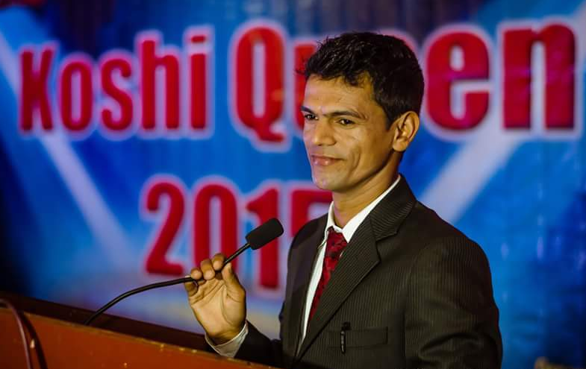
wGoafb

